Slide 1


Machine Learning Hackathon
Team Name - Data Detectives
Team Members - Nalla Perumal M, Vijay Srinivasan P
Team Leader Name- Vijay Srinivasan P
Team Leader Email Address- visin109@gmail.com

Slide 2
Brief Description of the Problem at hand:
The problem given is a classification problem in the field of healthcare advertising. The objective is to build a model that can accurately predict whether a user belongs to the HCP category and determine their specialization or taxonomy based on ad server logs.
The ad server logs contain valuable information such as device type, platform ID, IP address, user ID, city, ZIP code, user agent, platform type, channel type, URL, keywords, taxonomy, and an indicator variable (IS_HCP) specifying whether the user is an HCP or not.
This problem is relevant in the field of healthcare advertising, where understanding the user's professional background and specialization is crucial for targeted advertising.
To solve this problem, machine learning techniques can be employed. Historical data with known HCP categories and taxonomies can be used to train a model. Various classification algorithms can be applied, and feature engineering methods can be employed to extract meaningful information from the ad server logs.

Slide 3
Brief Description of the Problem at hand:
The model's performance can be evaluated using appropriate metrics, and adjustments can be made to improve its accuracy. Once the model is trained and validated, it can be used to predict the HCP category and taxonomy for new instances of ad server logs.
The goal is to build a robust model using machine learning techniques to classify users as HCPs and identify their specialization.
Once the model is trained and evaluated, it can be used to predict the HCP category and taxonomy for new instances of ad server logs.
By successfully solving this problem, advertisers and marketers can better target their campaigns towards HCPs, resulting in more effective and relevant advertising strategies.

Slide 4
Solution proposed and description:
To address the problem of classifying users as Healthcare Professionals (HCPs) and determining their specialization or taxonomy based on ad server logs, the following solution is proposed:
Data Preprocessing: The ad server logs need to be preprocessed before building the model. This includes handling missing values, converting categorical variables to numerical representations, and performing feature scaling or normalization if required.
2.Feature Selection: Relevant features need to be selected or engineered from the ad server logs to capture important information related to HCP classification and specialization. This may involve extracting information from the user agent, URL, keywords, or other fields that could be indicative of an HCP's behavior or specialization.

Slide 5
Solution proposed and description:
3.Feature Engineering: In the feature engineering step, several techniques were applied to process and encode the features in the dataset. Specifically, the "KEYWORDS" column was converted into numerical vector representations using a word2vec model. This allowed capturing the semantic meaning and similarity between different medical keywords.
Additionally, other important features were encoded using various methods such as one-hot encoding, label encoding, and count encoding. One-hot encoding is used to represent categorical variables as binary vectors, label encoding assigns a unique numerical label to each category, and count encoding represents each category with the count of its occurrences(used for URL’s).
4..Model Training: Various machine learning algorithms can be employed to train a classification model on the preprocessed data. This could include algorithms such as logistic regression, decision trees, random forests, gradient boosting, or deep learning approaches. For this we used Random forest classifier because Random Forest has the ability to capture complex feature interactions and non-linear relationships between features. In the case of given dataset of categorical variables, RF can automatically learn and consider interactions between different categories within a feature especially with lots of medical terms which can be critically used to identify taxonomy and hcp’s.

Slide 6
Solution proposed and description:
5.Model Evaluation: The trained model needs to be evaluated using appropriate metrics such as accuracy, precision, recall, and F1 score to assess its performance in classifying users as HCPs and predicting their specializations. Cross-validation techniques like k-fold cross validation were applied to ensure the model's generalizability and mitigate overfitting.
6.Filling Taxonomies:
Created a taxonomy map with entire keyword and taxonomy and keyword taxonomy map with each medical term with its list of associated taxonomies. For predicted hcp who are hcp are first compared with taxonomy_dict and corresponding taxonomies are filled.
For Keywords that don’t match, the cosine similarity between the keyword vector of each row in the dataframe and the keyword vectors in the keyword_vector1 dictionary. It finds the top similar keywords based on the highest similarity scores and retrieves their associated taxonomies from the keyword_taxonomy_map. It then determines the most common taxonomy among the top neighbors and updates the 'taxonomy' column in the dataframe
7.By accurately classifying users as HCPs and predicting their specializations, this solution enables targeted advertising campaigns in the healthcare domain. Advertisers and marketers can leverage this information to deliver more relevant and personalized advertisements to the intended audience, resulting in improved engagement and effectiveness of their campaigns.

Slide 7
Approach(steps):
Data Preparation: Start by loading and preprocessing the ad server logs data. This includes handling missing values, converting categorical variables into numerical representations (e.g., one-hot encoding or label encoding), and splitting the data into training and test sets.
2. Feature Engineering: Extract meaningful features from the available data. For example, parse the user agent field to extract browser details and operating system information. Extract geographic information from the user's IP address such as country, region, or city. Extract keywords from the URL field. These engineered features will provide additional information that can aid in predicting the user's HCP category and taxonomy.
3. Model Training for HCP Classification: Build a machine learning model to predict whether a user belongs to the HCP category. Choose a suitable classification algorithm such as logistic regression, decision tree, random forest, or gradient boosting. Train the model using the training dataset, using relevant features and the HCP label (IS_HCP).

Slide 8
4. Model Training for Taxonomy Prediction: For users identified as HCPs (IS_HCP = 1), build a separate model to predict the taxonomy or specialization. This can be done using the subset of the training dataset where both IS_HCP and taxonomy fields are populated. Again, select an appropriate classification algorithm and train the model using relevant features and the taxonomy labels.
5.Model Evaluation: Evaluate the performance of the trained models using appropriate evaluation metrics such as accuracy, precision, recall, and F1 score. Use the test dataset for evaluation to assess how well the models generalize to unseen data.
6.Generate Predictions: Apply the trained models to the ad server logs data to generate predictions for HCP category and taxonomy. For each user in the dataset, use the models to classify whether they belong to the HCP category and predict their specialization.

Slide 9
7. Model Refinement: If the model's performance is not satisfactory, explore different algorithms, adjust hyperparameters, or consider additional feature engineering techniques to improve the results. Iterate on the model refinement process to enhance the accuracy and robustness of the predictions.
8. Documentation and Reporting: Document the entire process, including data preprocessing steps, feature engineering, model selection, training methodologies, evaluation metrics, and results. Provide a comprehensive report outlining the approach, findings, challenges faced, and recommendations for further improvements
9. Regularly evaluate and update the model as new data becomes available to maintain its relevance and effectiveness over time.

Slide 10
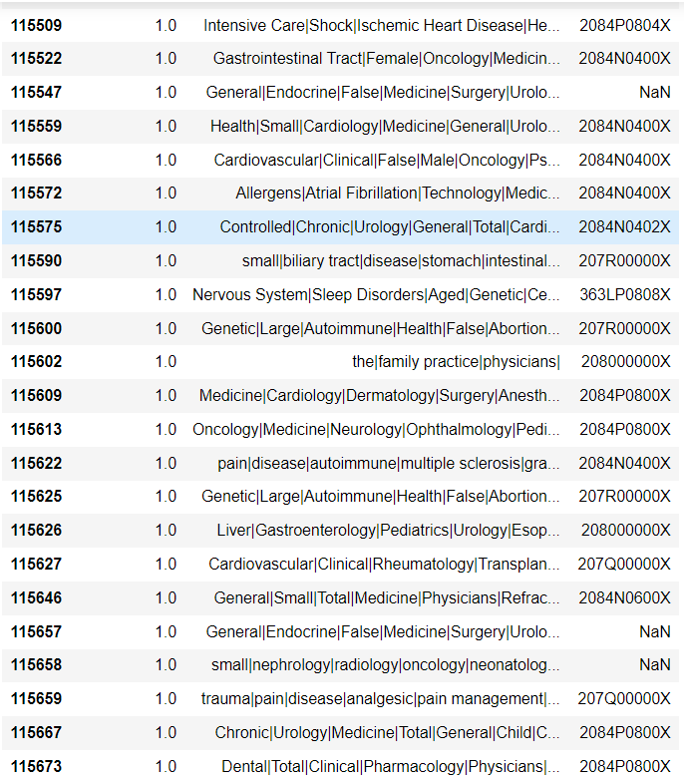
Output screenshts of the solution:
Predicted taxonomies for HCPs and “no taxonomy for not a hcp”

Slide 11
Source code in ZIP file/Github URL:
Github link doceree-hackathon

Slide 12
Additional comments (optional):
Hyperparameter Tuning: Tune the hyperparameters of the selected models to optimize their performance. This can be done using techniques like grid search or randomized search, exploring different combinations of hyperparameters to find the best configuration.
Model Interpretability: Assess the interpretability of the chosen models and select techniques to interpret their decisions. This can help in understanding the factors influencing the prediction of the HCP category and taxonomy, providing transparency and trust in the model's predictions.
Model Deployment: Once the best-performing model is identified, prepare it for deployment. This involves saving the trained model and its associated preprocessing steps for future use. Ensure that the deployment process is well-documented and consider the infrastructure requirements for serving the model in a production environment.

Slide 13
THANK YOU!

